Slide 1
What affects lender yield?
by Yehudit Yeret

Slide 2
Investigation Overview
For the presentation, I focused on the quality and numeric metrics that impact lender yield, EstimatedLoss, and refundability: ProsperRating, EmploymentStatus, IncomeRange.
Dataset Overview
The loan_filter dataset has 14 columns and 84,853 rows starting from July 2009, I filtered the dataset to columns that I think impact the lender yield, features that reflect the level of, the loan original amount, and term. I took only the rows that ListingCreationDate was after July 2009, because some parameters applicable for loans originated after July 2009.

Slide 3
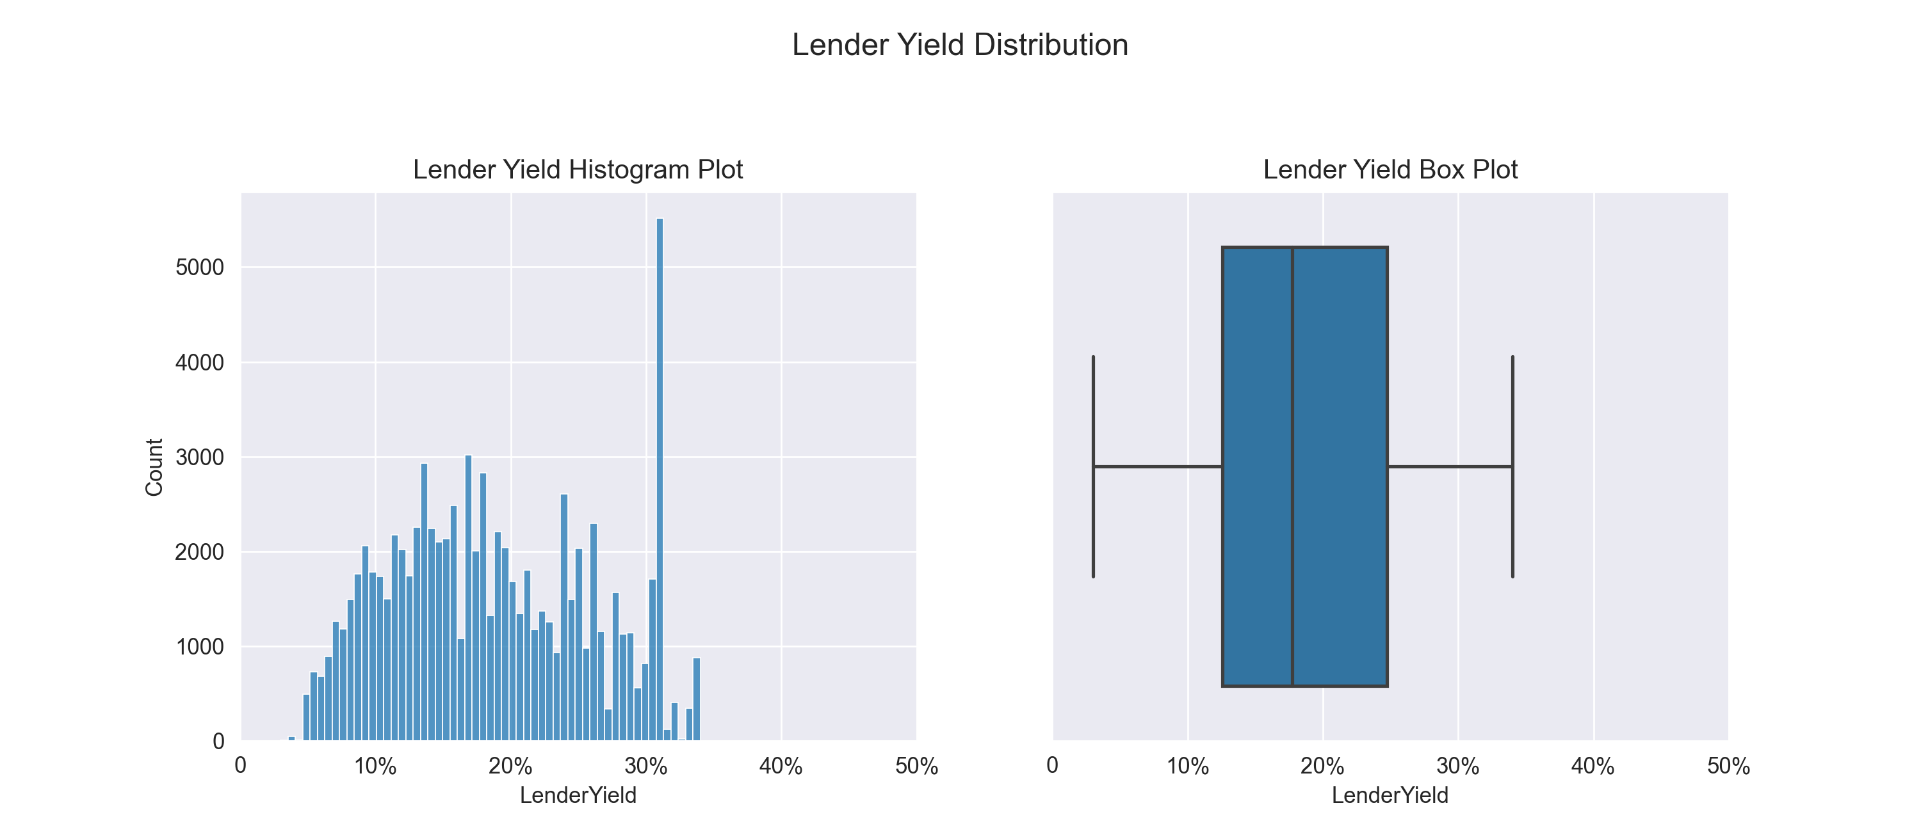
Lender Yield Distribution
from the histogram and the box plot we could see that the lender yield approximates a normal

Slide 4
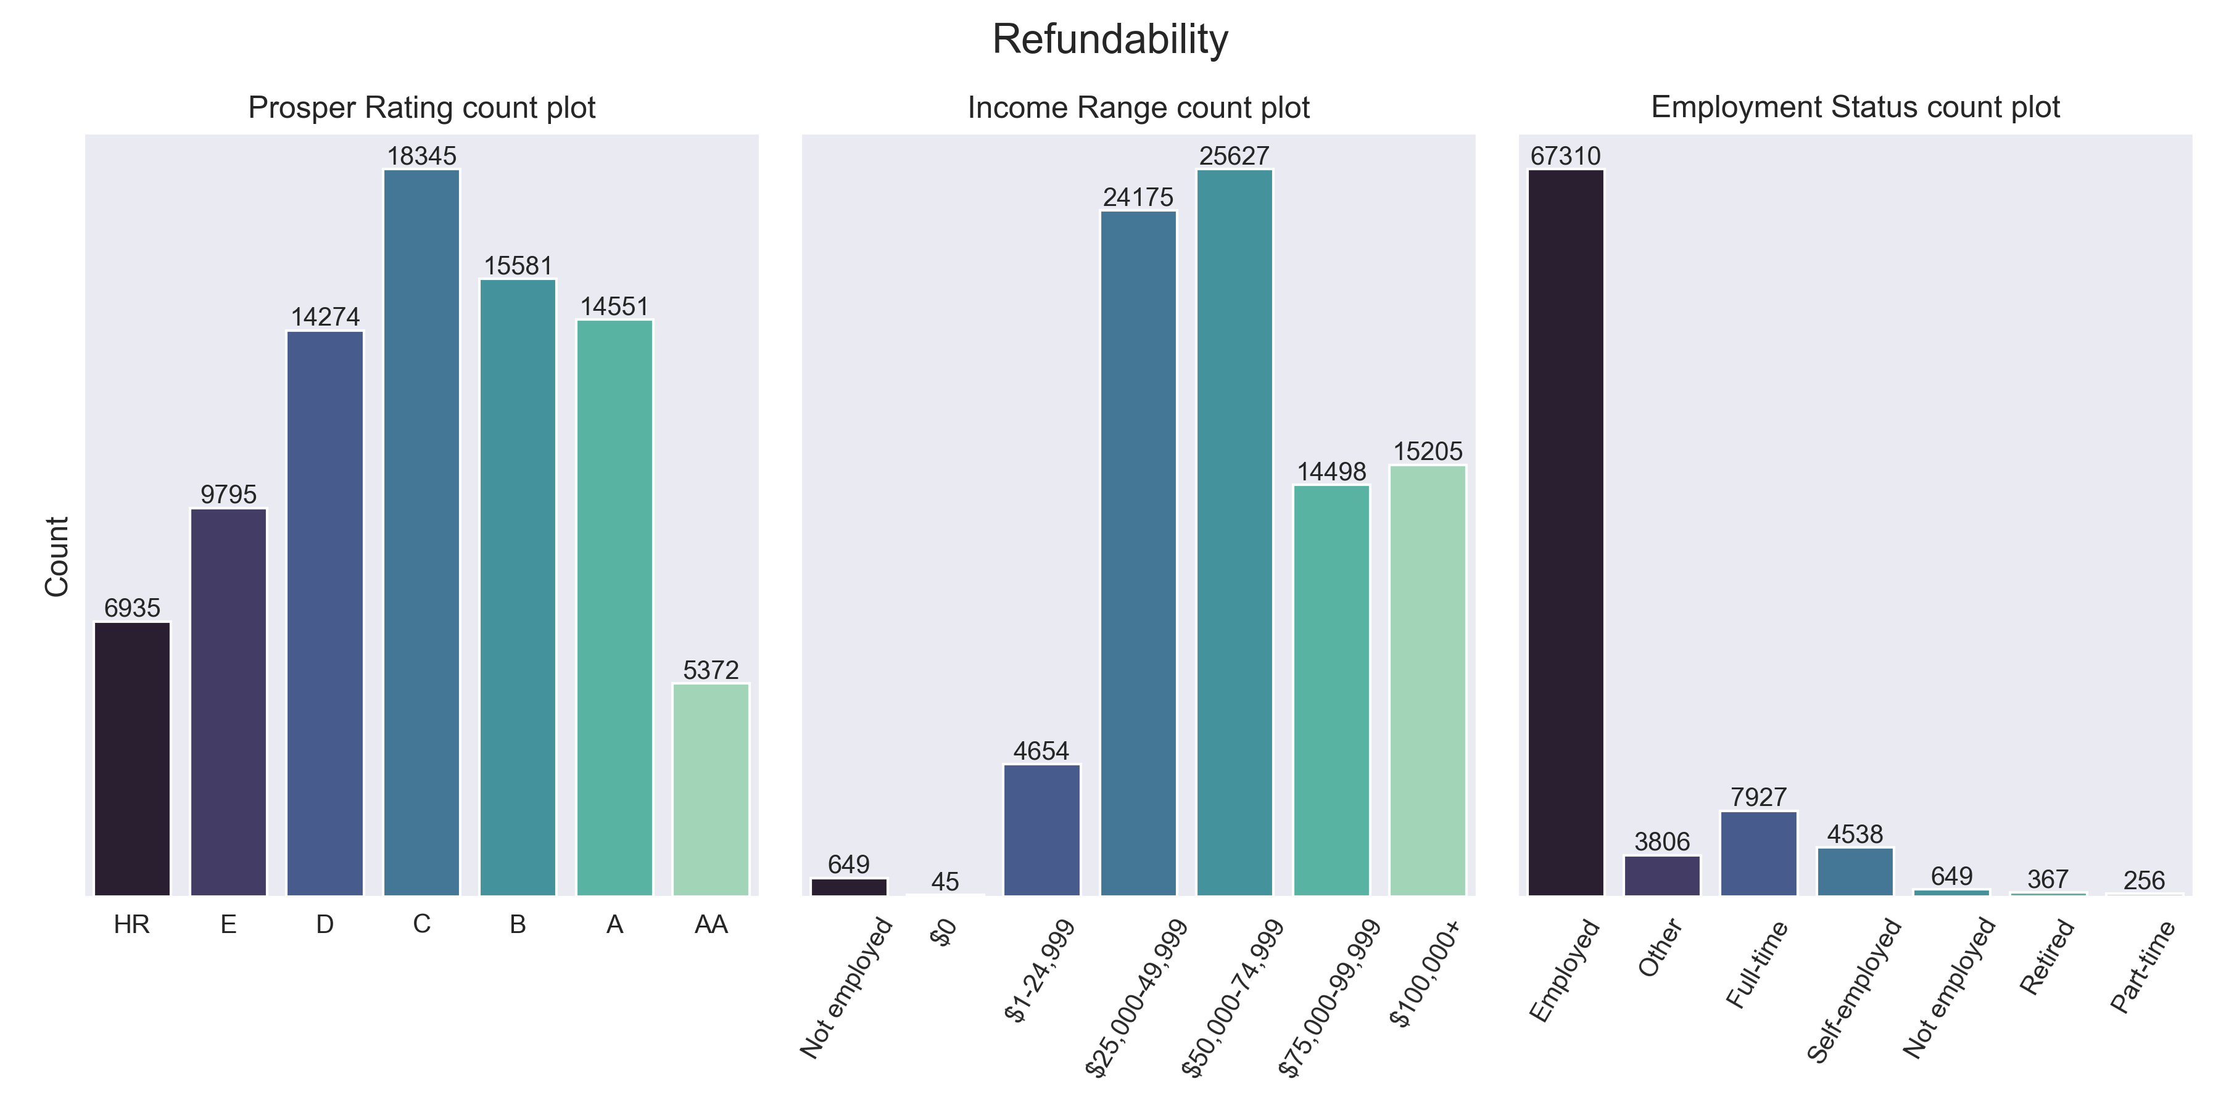
Refundability

Slide 5
refundability
we can see that prosper-rating AA has the lowest number of loans maybe it's because peoples with very good rates need fewer loans, after that, we saw the HR rate with 6935 loans because they have the lowest refundability.
in the second chart we see that people that not employed and people with 0$ income (which is the same thing) have a lower amount of loans because it's hard to pay a loan without income.
in the last plot the highest bars are employed and full-time, these indicators make the loans less risky.

Slide 6
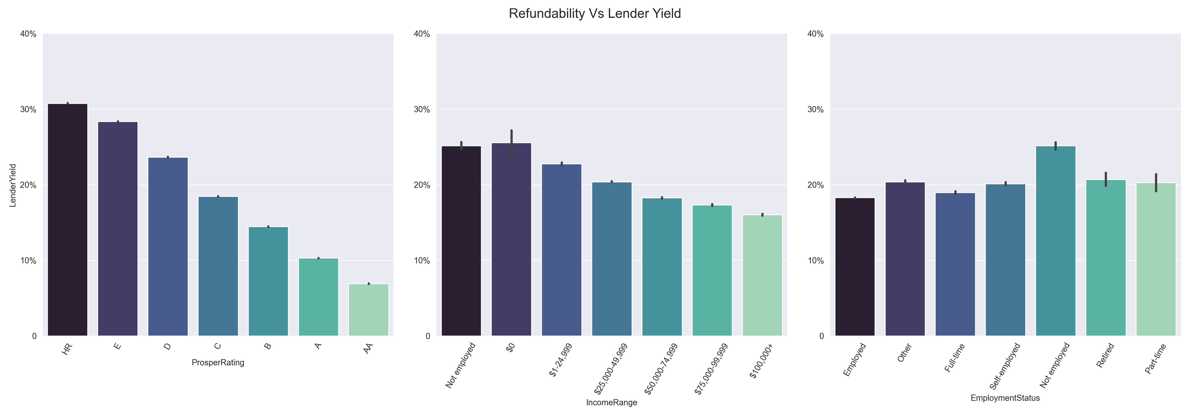
The Connection Between Lender Yield And Refundability
It's very clear that low-income or rate leading the highest lender yield percent, in the last plot (employment status) the thing that we can see for sure that not employed has the highest lender yield percent.

Slide 7
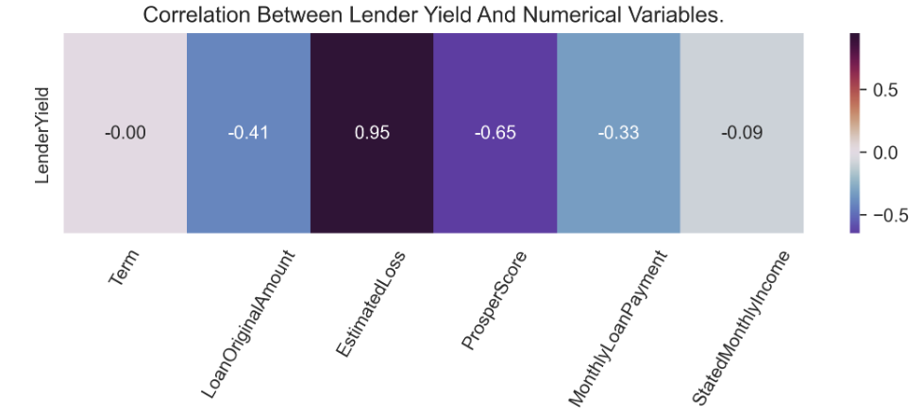
Relationship Between Lender Yield And Estimated Loss
We see a strong positive correlation between lender yield an estimated loss, it shows that estimated loss has a large impact on lender yield.

Slide 8
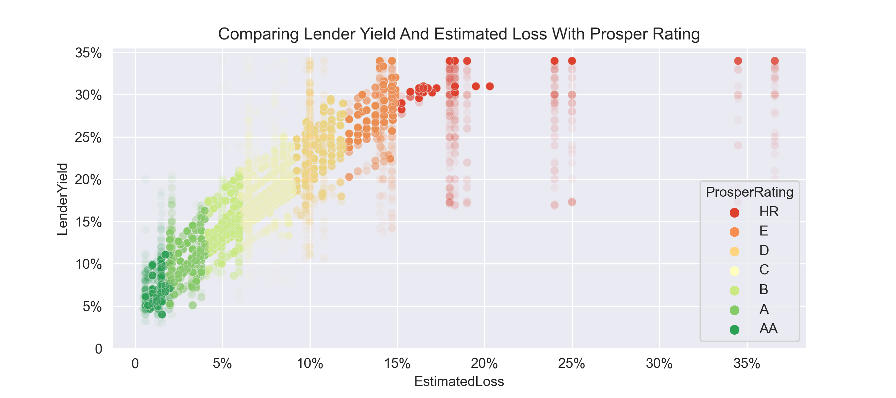
Comparing Lender Yield And Estimated Loss With Prosper Rating
We can see that when we have a lower Prosper rating the lender yield and estimated loss are higher.

Slide 9
Conclusions
we can see that the lender yield distribution looks normal
refundability (ProsperRating, EmploymentStatus, IncomeRange), when the refundability is higher, the lender yield is lower.
EstimatedLoss has a strong positive correlation with lender yield.
when we have a lower Prosper rating the lender yield and estimated loss are higher

